Slide 1
Learning Online Discussion Structures by Conditional Random Fields
Hongning Wang, Chi Wang, ChengXiang Zhai and Jiawei Han
Department of Computer Science
University of Illinois at Urbana-Champaign
Urbana IL, 61801 USA

Slide 2
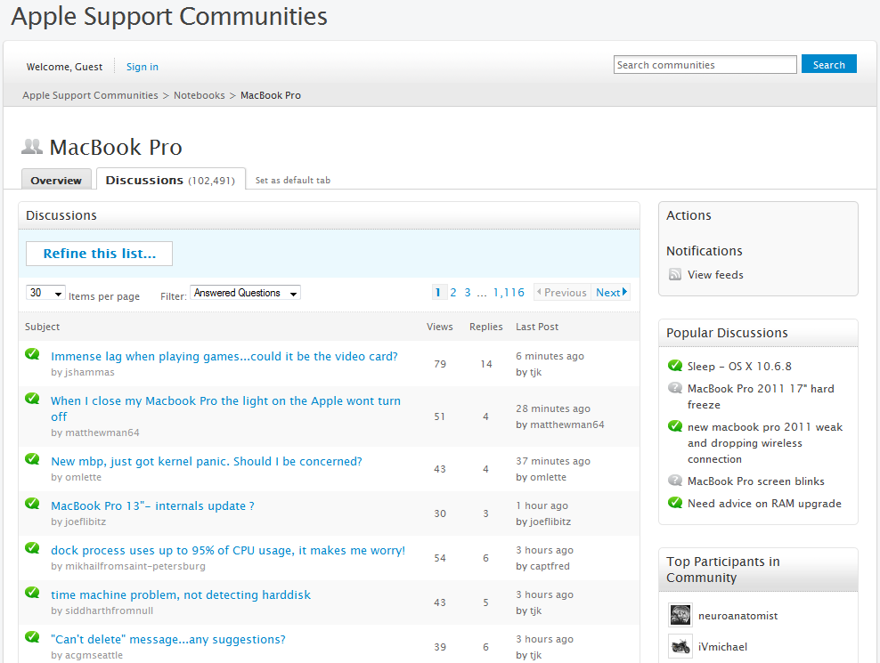
Introduction
Online forum: a rich information repository^{[1,2]}
Interactive accumulation
Various topics

Slide 3
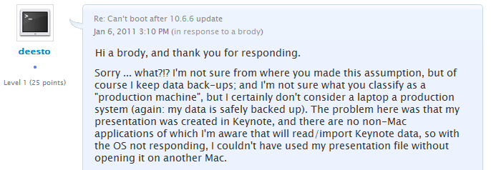
A Typical Forum Discussion

Slide 4
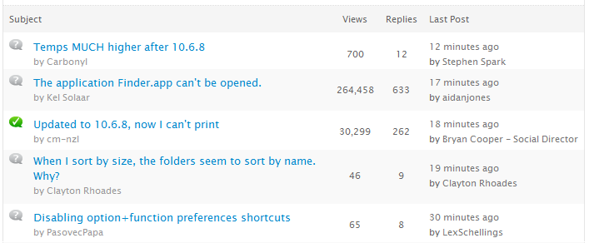
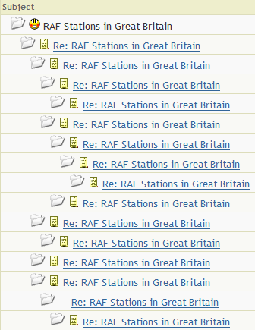
Information Hidden in Structures
Replying relationship
Convey important information about the discussion^{[2]}
Structure is not always visible
Flat View
Threaded View
v.s.

Slide 5
Structure Reconstruction
0
1
3
Existing method
Content modeling: topic models^{[3]}
Ranking approach: retrieve parent post^{[4]}
Beyond content analysis
Posts are usually short
Temporal dependency
User interaction
Our approach: structural learning
2
4

Slide 6
Problem Definitions
Previous post
Chain structure
0
1
2
3
4
Time line
0
deesto Jan 6, 2011 11:06 AM
I see lots of new complaints here about system slowness, apps not working, etc., but after updating my MacBook Pro from 10.6.5 to 10.6.6, I can no longer boot into OS X.
Root post
Tree structure
1
3
Post ID
a brody Jan 6, 2011 12:59 PM
Never upgrade a production machine without a backup. Unfortunately you can forget about the presentation. First step is to recover: http://www.macmaps.com/backup.html#RECOVER
Frank Miller2 Jan 6, 2011 2:19 PM
I suggest you start this machine in 'target disk' mode - shut it down, then restart it with the 'T' key held down while it is connected to another Mac with a FireWire cable.
Author name
Post time
Parent post
Post content
2
4
Deesto Jan 6, 2011 2:08 PM
Hi a brody, and thank you for responding. I'm not sure from where you made this assumption, but of course I keep data back-ups; and I'm not sure what you classify as a "production machine"
deesto Jan 6, 2011 2:29 PM
Thanks Frank. But I really only have one Mac: this one. My personal files are not at risk: I have backups, and obtaining the files off of the machine is not a problem.

Slide 7
threadCRF
Probabilistic graphical model
Conditional probability
CRFs framework
Features
Model
Prediction
0
p( |posts)
p( | , )
4
0
0
4
1
2
3
4

Slide 8
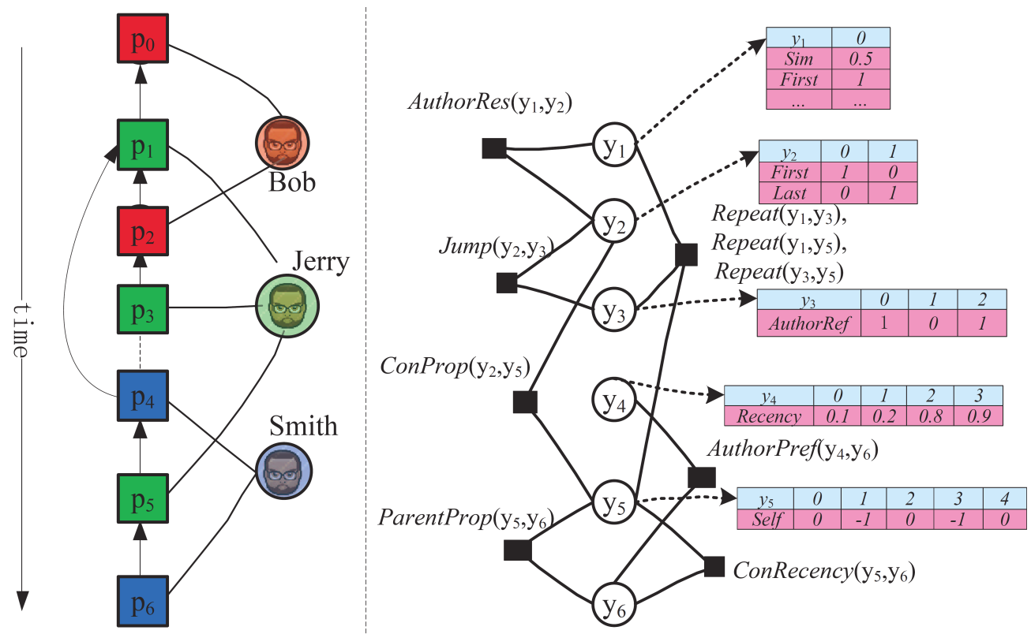
Features
Node features
Local potential of replying relations
Edge features
Long-range dependency among the predictions

Slide 9
Node Features
Content
Reply pattern
Author interaction
Temporal proximity
0
1
3
2
4
Content sharing

Slide 10
Edge Features
Content
Reply pattern
Author interaction
Temporal proximity
0
1
3
2
4
Discuss parallel aspects
Context propagation
Do not repeatedly reply
Do not jump back
Reply to one replied to you
Reply to one you have replied to
Reply to one closest in sub-discussion

Slide 11
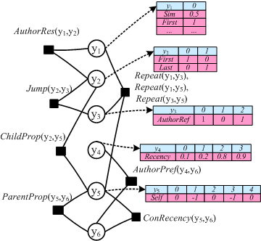
Inference and Model Learning
MAP inference
Exact inference is intractable
Approximate inference
Tree reweighted message propagation^{[5]}
Maximum likelihood
Gradient

Slide 12
Experiments
Evaluation criterion
0
0
1
0
0
1
3
1
3
2
1
2
3
4
2
4
2
4
3
4
(a) Ground-truth
(b) LAST
(c) FIRST
(d) threadCRF
Edge accuracy
0.75
0.5
0.75

Slide 13
New Evaluation Metrics
0
1
3
Path accuracy
Path precision & recall
Node precision & recall
2
4
(a) Ground-truth
0
1
0
2
1
3
3
2
4
4
(b) FIRST
(c) threadCRF

Slide 14
Quantitative evaluations
Forum Data Set
Apple discussion (http://discussions.apple.com)
Google earth community (http://bbs.keyhole.com)
CNET (http://forums.cnet.com)

Slide 15
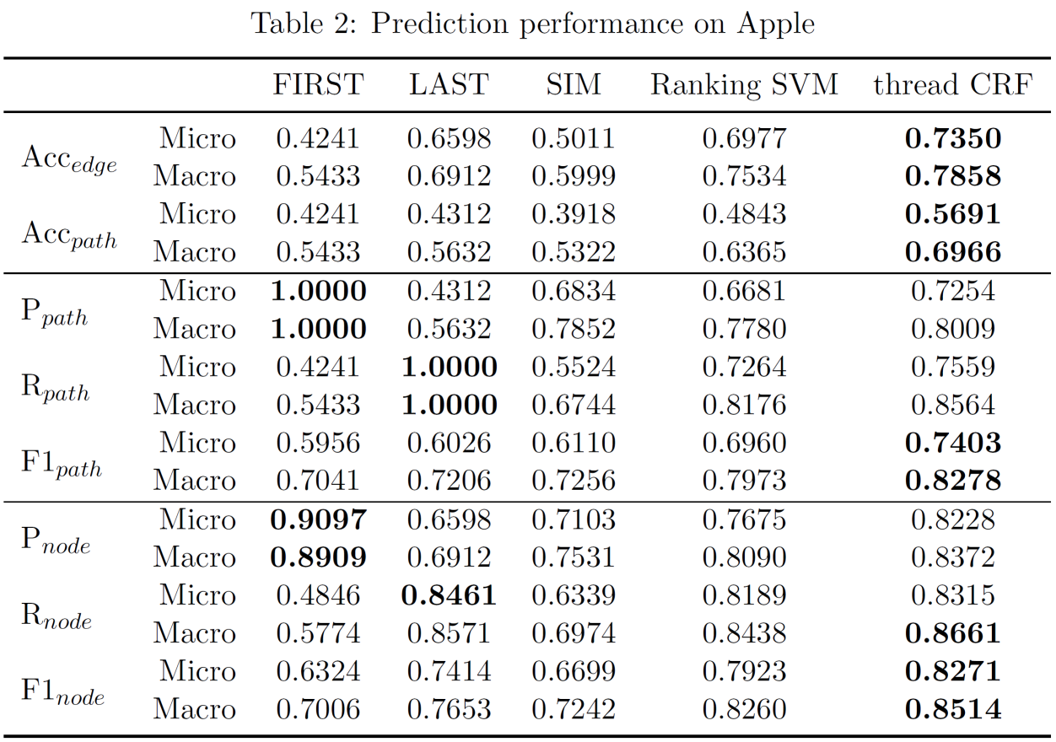
Replying Relation Reconstruction I
Baseline
FIRST, LAST, SIM, Ranking SVM^{[4]}
Apple Discussion
75% training, 25% testing

Slide 16
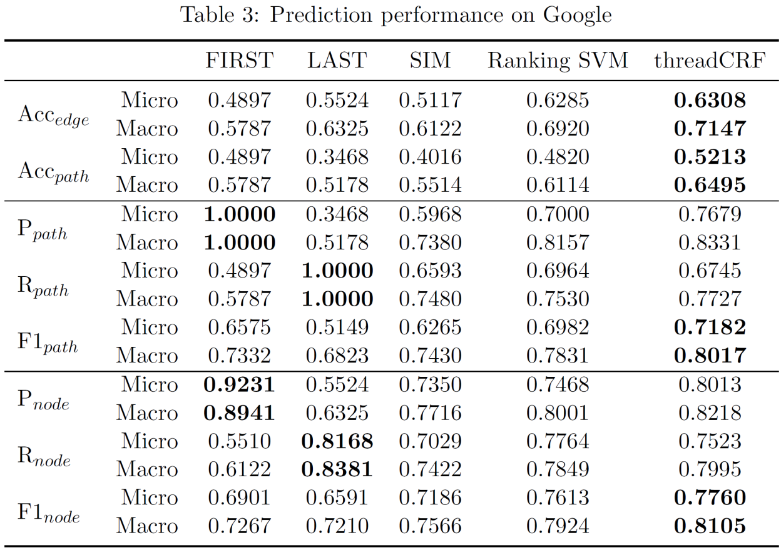
Replying Relation Reconstruction II
Baseline
FIRST, LAST, SIM, Ranking SVM^{[4]}
Google Earth Community
75% training, 25% testing

Slide 17
Replying Relation Reconstruction III
Prediction performance on long threads
Threads with more than 10 posts

Slide 18
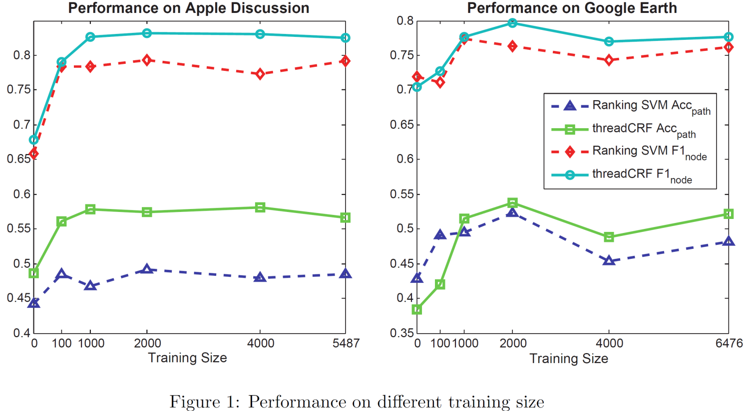
Adaptability Evaluation I
Varying training size

Slide 19
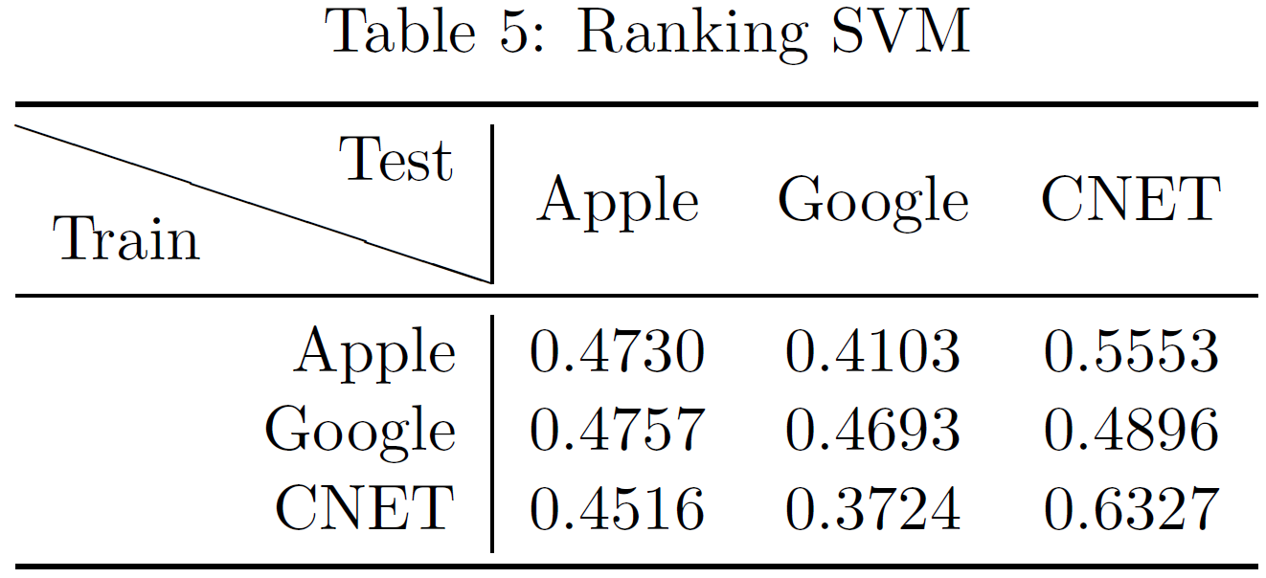
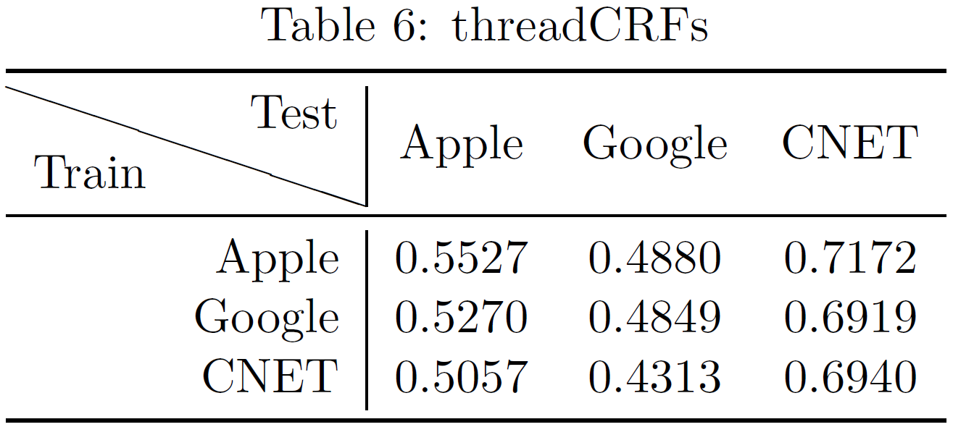
Adaptability Evaluation II
Cross domain testing
2000 v.s. 2000 threads from each domain

Slide 20
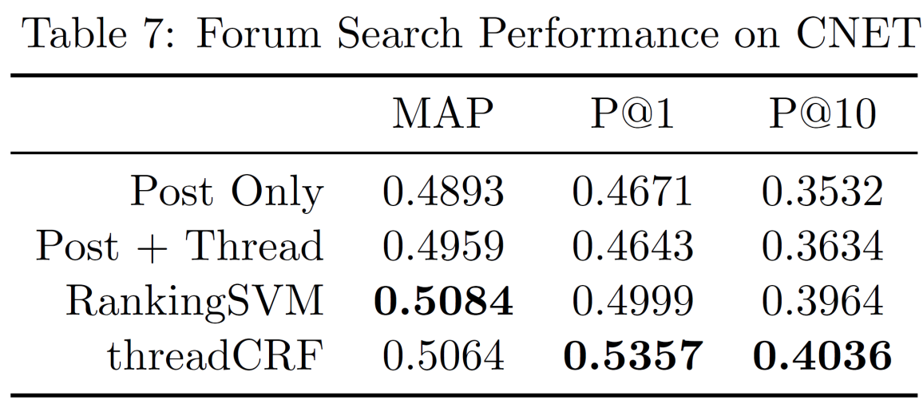
Applications
Forum search
Using thread structure to smooth language models^{[6]}
30 queries with 900 annotated posts from CNET

Slide 21
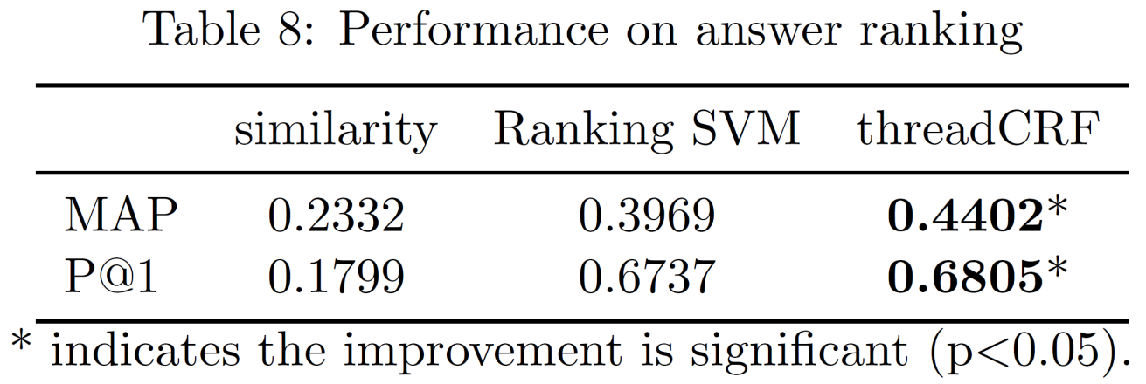
Application II
Community Question Answering
Answer post retrieval in Apple Discussion
Ranking criterion

Slide 22
Conclusion
Replying relationship reconstruction
threadCRF
Rich features: short-range and long-range dependencies
Novel evaluation metrics
Future directions
Micro-blogs: twitter, facebook
Advanced content analysis

Slide 23
Acknowledgment
SIGIR 2011 Student Travel Grant

Slide 24
References
G. Cong, L. Wang, C. Lin, Y. Song, and Y. Sun. Finding question-answer pairs from online forums. In Proceedings of the 31st SIGIR, pages 467–474, 2008.
J. Zhang, M. Ackerman, and L. Adamic. Expertise networks in online communities: structure and algorithms. In Proceedings of the 16th WWW, pages 221–230, 2007.
C. Lin, J. Yang, R. Cai, X. Wang, and W. Wang. Simultaneously modeling semantics and structure of threaded discussions: a sparse coding approach and its applications. In Proceedings of the 32nd SIGIR, pages 131–138, 2009.
J. Seo, W. Croft, and D. Smith. Online community search using thread structure. In Proceedings of the 18th CIKM, pages 1907–1910, 2009.
M. Wainwright, T. Jaakkola, and A. Willsky. MAP estimation via agreement on trees: message-passing and linear programming. Information Theory, IEEE Transactions on, 51(11):3697–3717, 2005.
H. Duan and C. Zhai. Exploiting Thread Structure to Improve Smoothing of Language Models for Forum Post Retrieval. In Proceedings of the 33rd ECIR, 2011.

Slide 25
Thank you!
Q&A

